Slide 1
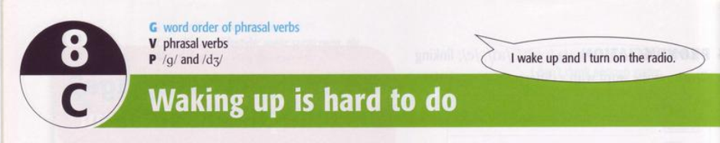

Slide 2
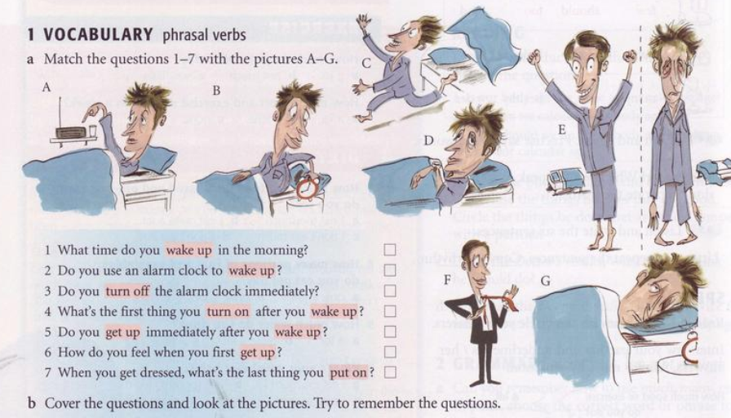
1 D | 2 G | 3 B | 4 A
5 C | 6 E | 7 F

Slide 3
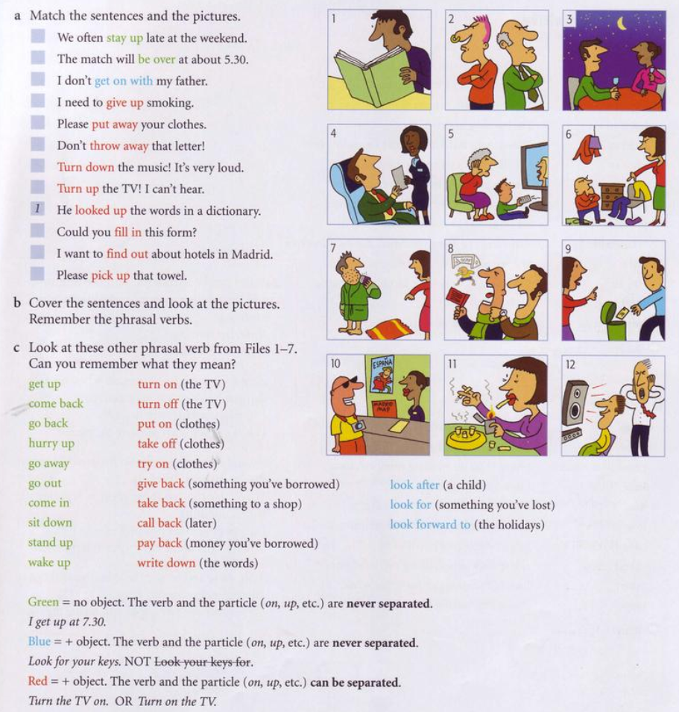
1 looked up | 7 pick up
2 get on with | 8 be over
3 stay up | 9 throw away
4 fill in | 10 find out
5 turn up | 11 give up
6 put away | 12 turn down

Slide 4
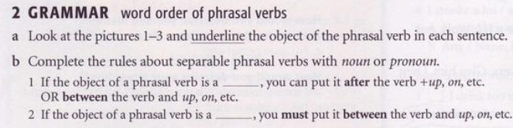
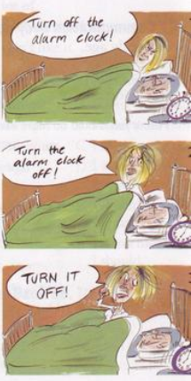
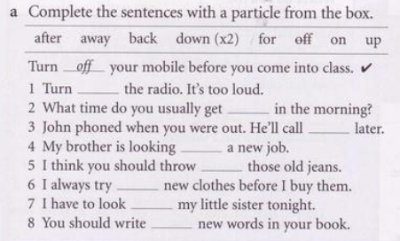
noun
pronoun
1 down | 2 up
5 away | 6 on
3 back | 4 for
7 after | 8 down

Slide 5
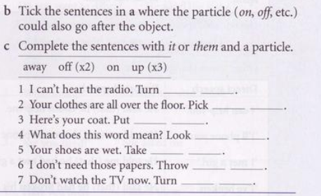

Slide 6
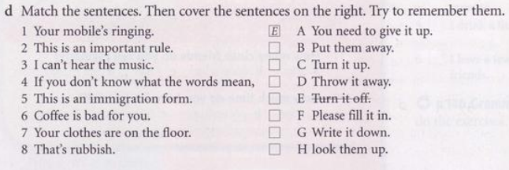

Slide 7
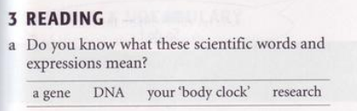
A gene is a part of the DNA in a cell that controls the physical development, behaviour, etc. of an individual plant or animal and is passed on from its parents:
ADN
Your body clock is your body’s natural need to sleep, eat etc… at a particular time
research is a detailed study of a subject, especially in order to discover (new) information or reach a (new) understanding

Slide 8
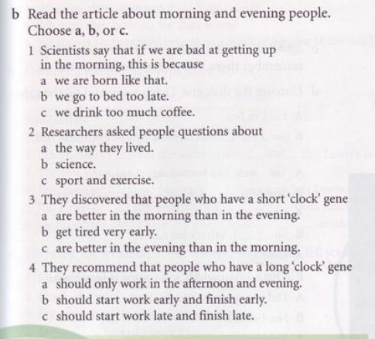
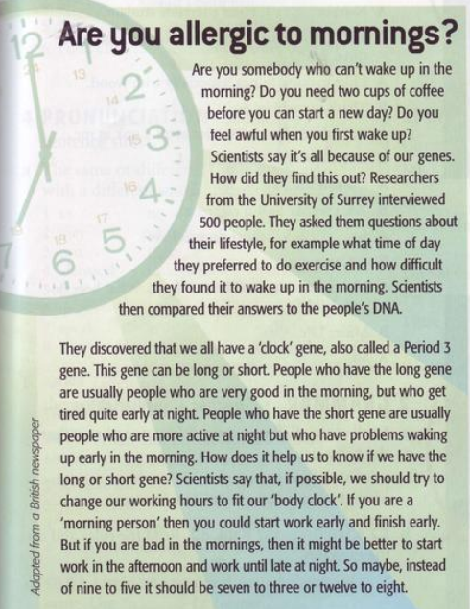

Slide 9
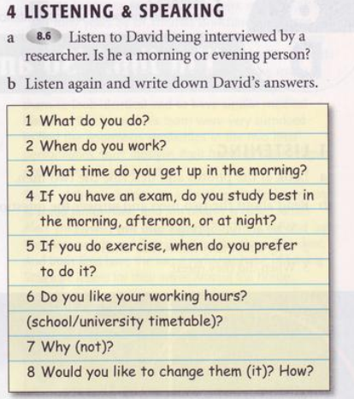

He’s a magazine editor
Monday to Friday. Eight till four
5’45
In the morning
In the morning
He doesn’t mind them
He can be with his daughter in the afternoon
Yes, I would. I’d like to work four days in a week and have 3 days at weekend

Slide 10
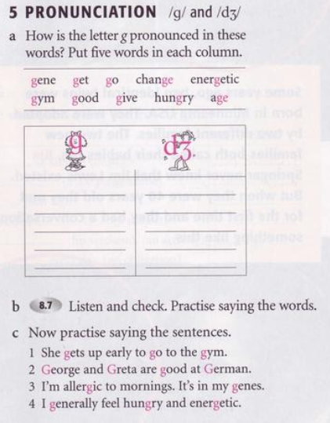
Get
Go
Good
Give
hungry
Gene
Change
Energetic
Gym
Age

